Slide 1
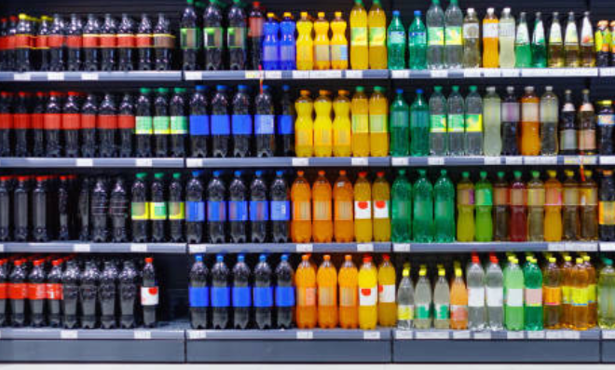
Cold drinks inventory management system

Slide 2
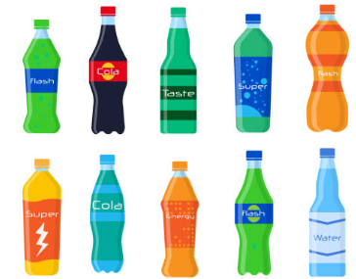
Project Description:
This Web application helps managing inventory systems using PC.
The mobiles displays the streaming of items in the front-end.
Deep learning model detects the items and automatically the number of items in the inventory gets updated and the updated inventory list will be shown in the front-end.

Slide 3




Technical Description:
Inventory items are being detected using YOLOv5 model.
The front-end is developed by using Streamlit.
Backend is developed by using Python.
Inventory Items are stored in SQLite database.

Slide 4
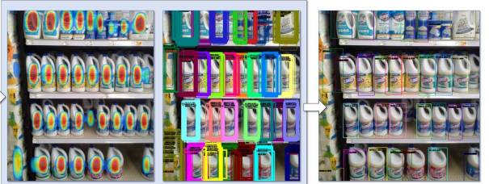
Data Set:
Data Set : SKU-110K
SKU-110K, the images are collected from thousands of supermarket stores and are of various scales, viewing angles, lighting conditions, and noise levels.
All the images are resized into a resolution of one megapixel.

Slide 5
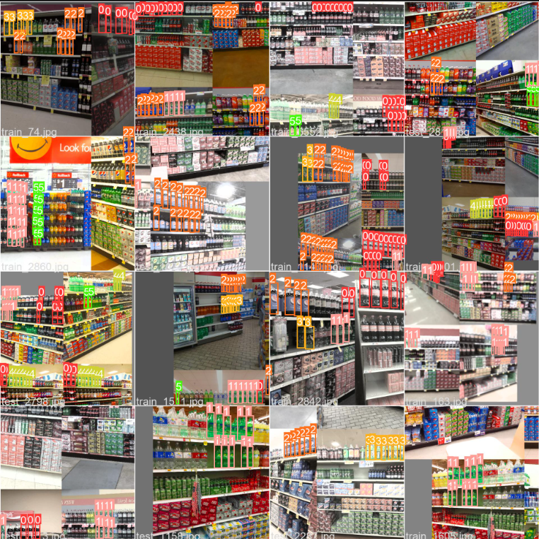
Data Set Labelling

Slide 6
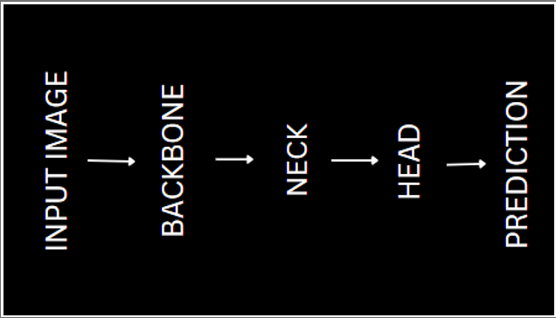
Architecture:
Model Name :YOLOv5
As YOLO v5 is a single-stage object detector, it has three important parts like any other single-stage object detector.
Model Backbone
Model Neck
Model Head

Slide 7
Backbone
Model Backbone is mainly used to extract important features from the given input image.
In YOLO v5 the CSPDarkNet (CSP — Cross Stage Partial Networks) are used as a backbone to extract rich in informative features from an input image.
It employs a CSPNet strategy which partition the feature map of the base layer into two parts and then merges them through a cross-stage hierarchy.
Darknet is fast and highly accurate which are the key requirements for the YOLO family.

Slide 8
Neck
PANet (Path Aggregation Network) is used as a neck in YOLO v5 to get feature pyramids.
Feature pyramids are a basic component in recognition systems for detecting objects at different scales.
The model’s neck role is to collect features from different stages. The neck is composed of several top-down paths and several bottom-up paths.
PANet uses features from all the layers, and decides which ones are useful.

Slide 9
Head
Yolo Layer is used as head. It uses anchor boxes to construct final output vectors with class probabilities, object-ness scores, and bounding boxes.
The head is responsible for :
the objectness score (the probability an object is within the anchor)
the class (a number i.e. 1 which corresponds to a class e.g. a person)
the class confidence (the chance that the above class is correct)
the bounding box coordinates i.e. [x, y, w, h] [120, 300, 200, 400]
The input is first passed to CSPDarknet for feature extraction, and then fed to PANet for feature fusion(Feature Pyramid). Finally, Yolo Layer outputs detection results (class, score, location, size).

Slide 10
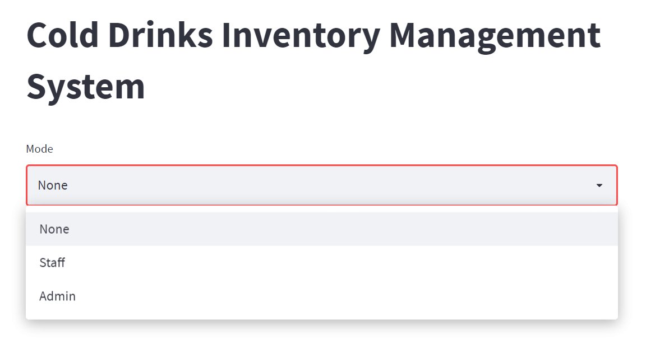
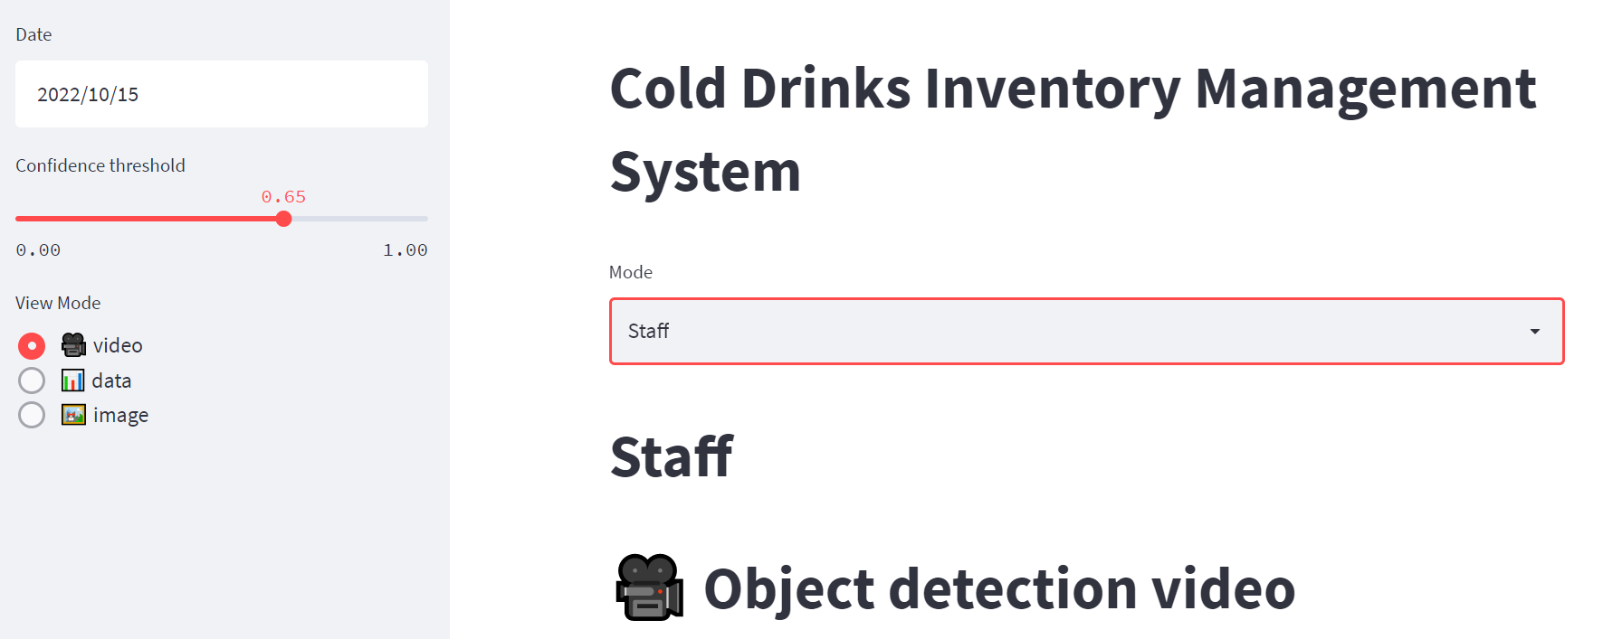
Work Flow

Slide 11
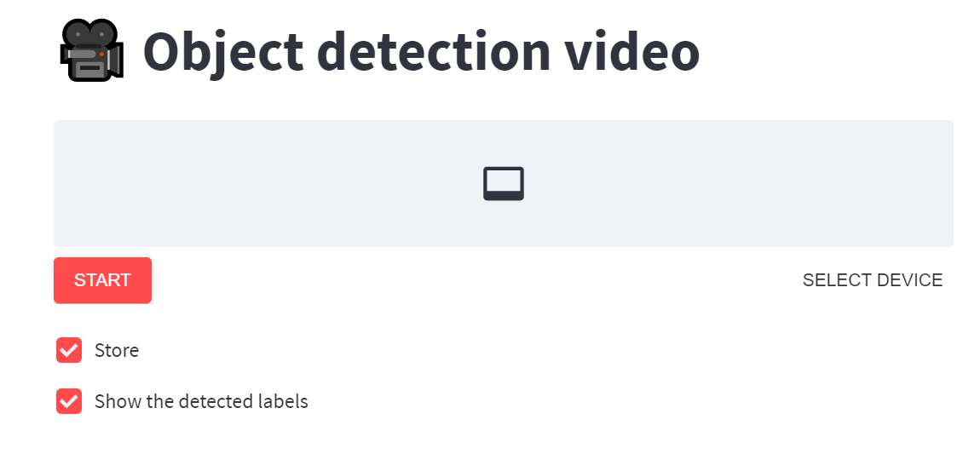
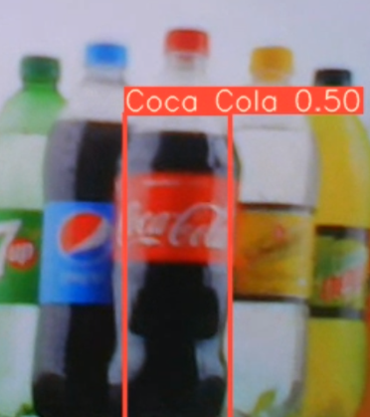
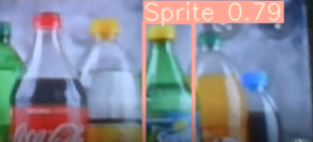
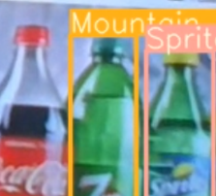

Slide 12
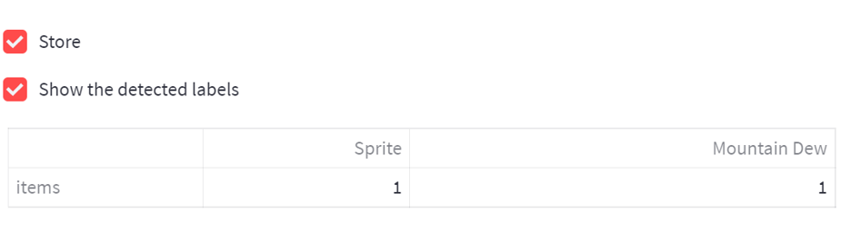
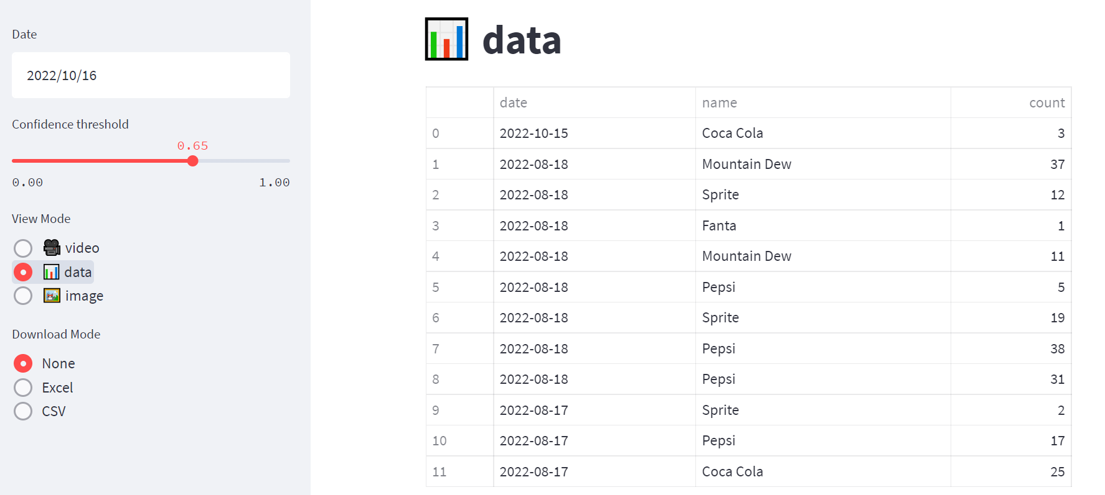

Slide 13
THANK YOU
Presented By
G DHRUTHI
B RUCHITA
G SHARAN

